Slide 1

SORTING VISUALIZATION
Member | Assignment
Nguyen Van Viet 20194883 | ElementBox, ElementBoxs, InitialElementBoxs, Instruction, PointRun, MergeSort.
Do Van Tuan 20194874 | CountingSort, RadixSort, Sort, SortFrame.
Vu Anh Tuan 20194878 | HelpFrame, MainApplication, MainFrame, SortFrame.
Instructor: Nguyen Thi Thu Trang

Slide 2
Problem Description
Merge Sort
Counting Sort
Radix Sort
TARGET
Help users have a better knowledge about how these sorting algorithms work.
PROBLEM
Make an application
to explain and visualize sorting algorithms.

Slide 3

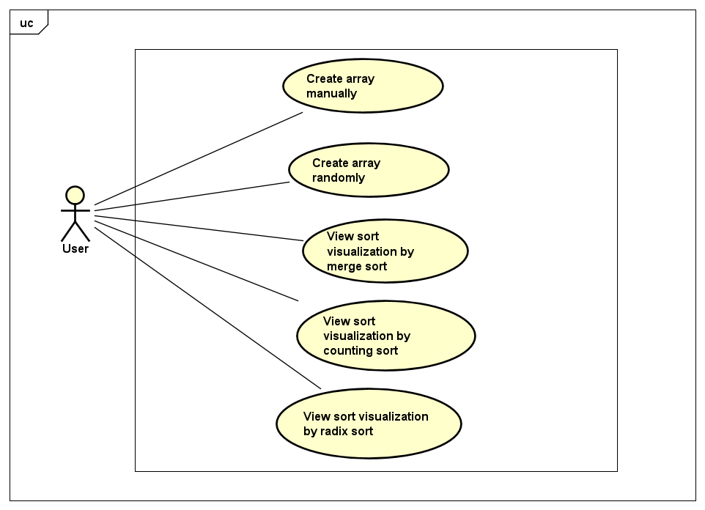

Use case diagram
User choose one sort type to start visualizing
User choose the number of elements of the array then
+ Create the array randomly
+ Input each element manually

Slide 4
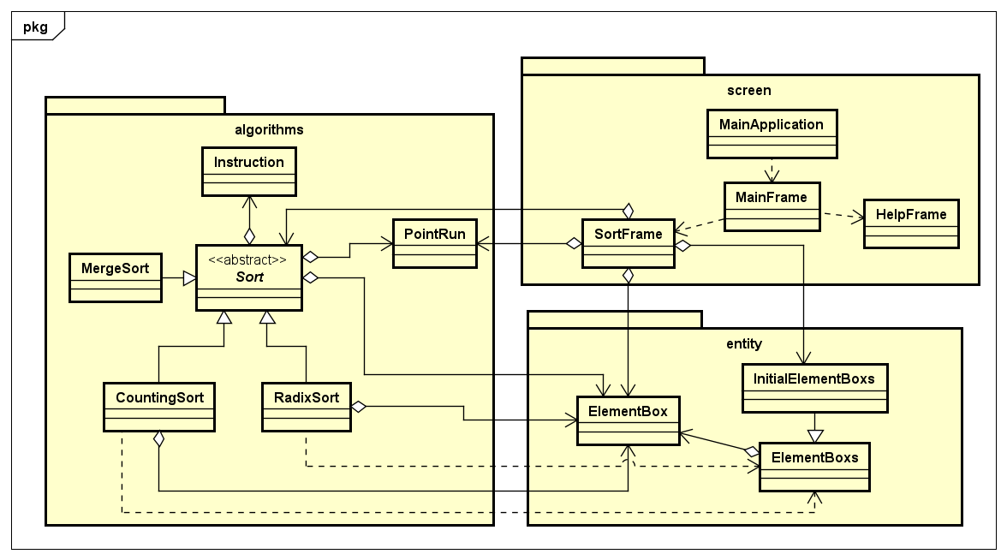
General Class Diagram

Slide 5
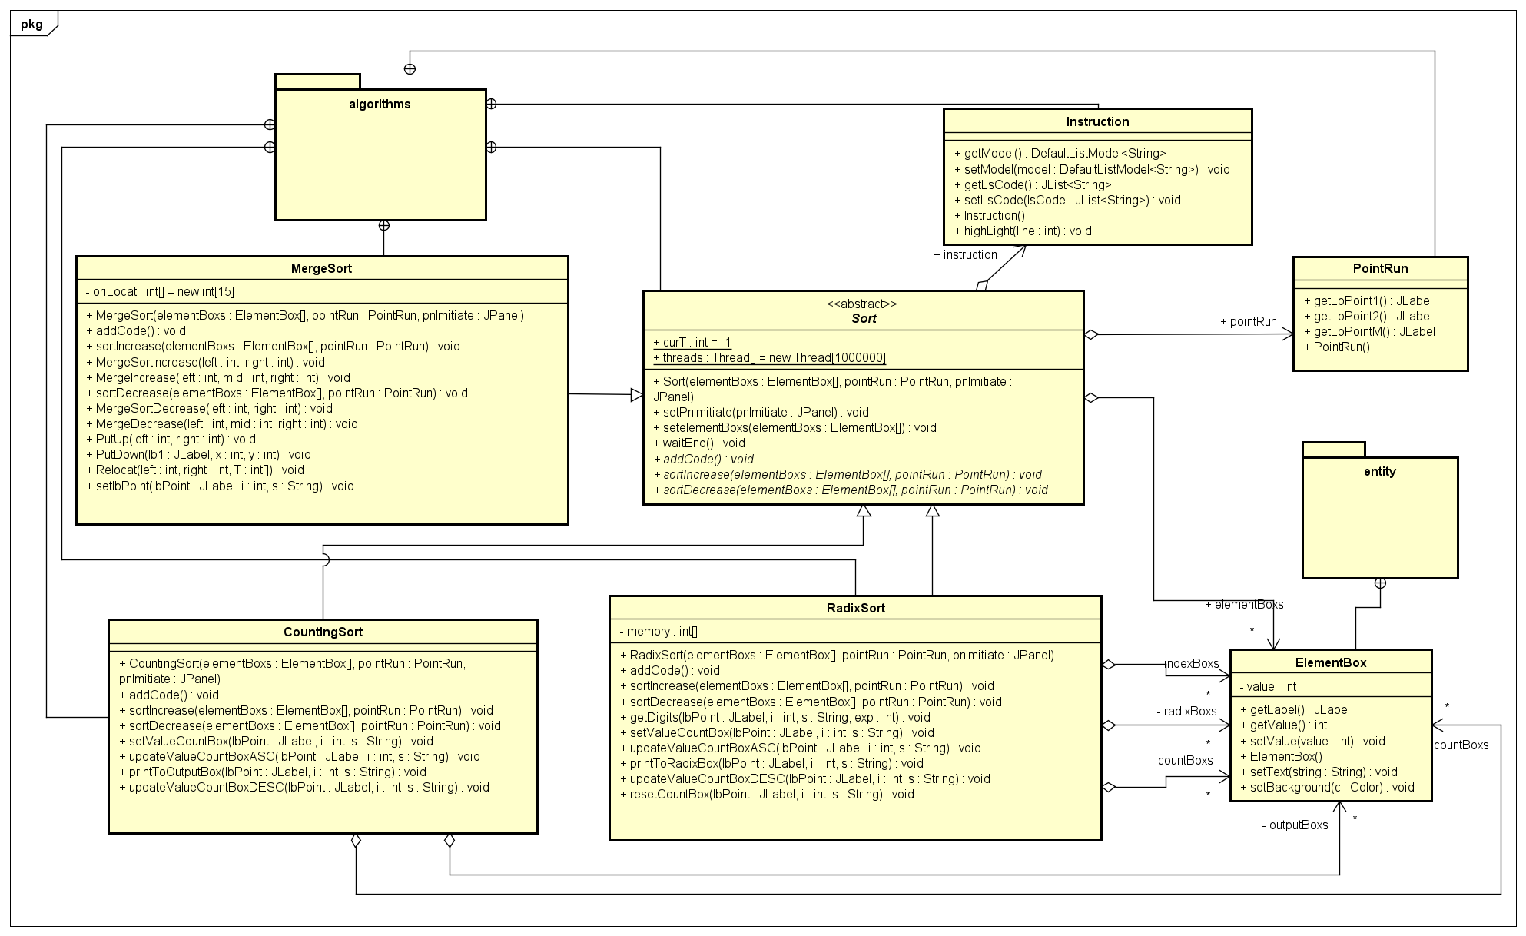

Slide 6
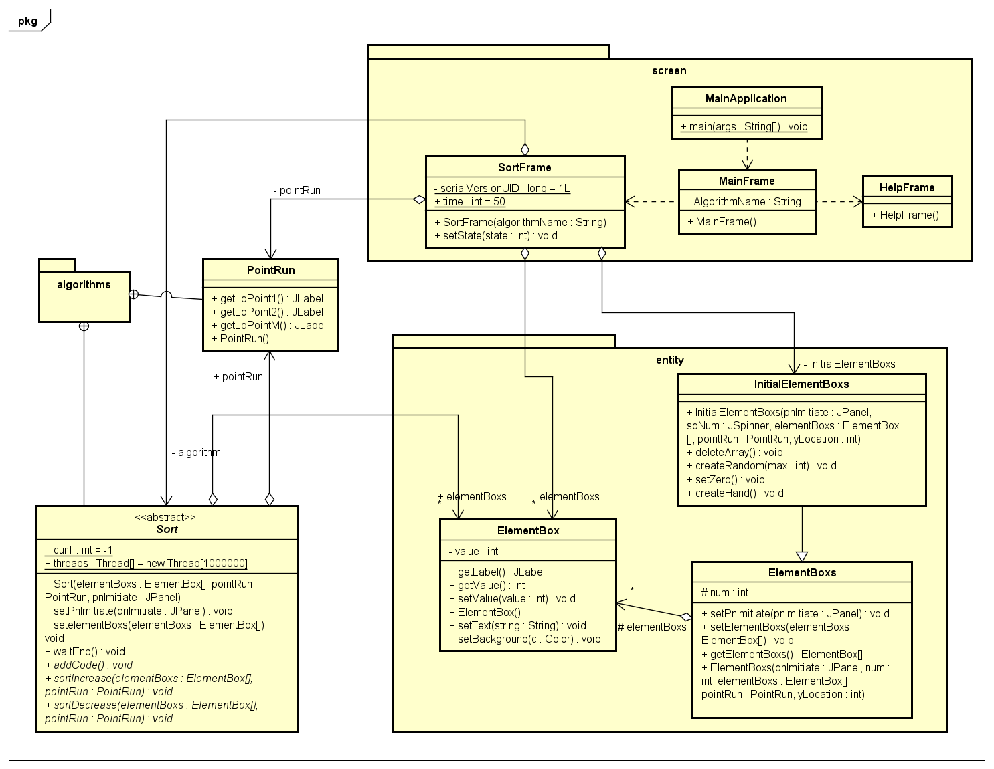

Slide 7
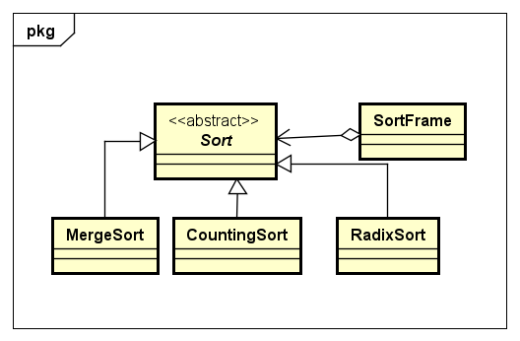
OOP Techniques
Inheritance
Three sort types inherit from Sort class.
InitialElementBoxs inherits from ElementBoxs.
Polymorphism
All specific sort algorithms are upcasted to the abstract class Sort, and used in SortFrame as attribute (algorithm: Sort)

Slide 8
OOP Techniques
Abstraction
We make Sort abstract because it is too general, and three sort types inherit Sort to create their instances.
Aggregation
PointRun, Sort, ElementBox and InitialElementBoxs are parts of SortFrame.
ElementBox is a part of ElementBoxs.
PointRun, Instruction and ElementBox are parts of Sort.
Beside one attribute of ElementBox inheriting from Sort, CountingSort and RadixSort have some other attributes of type ElementBox.

Slide 9
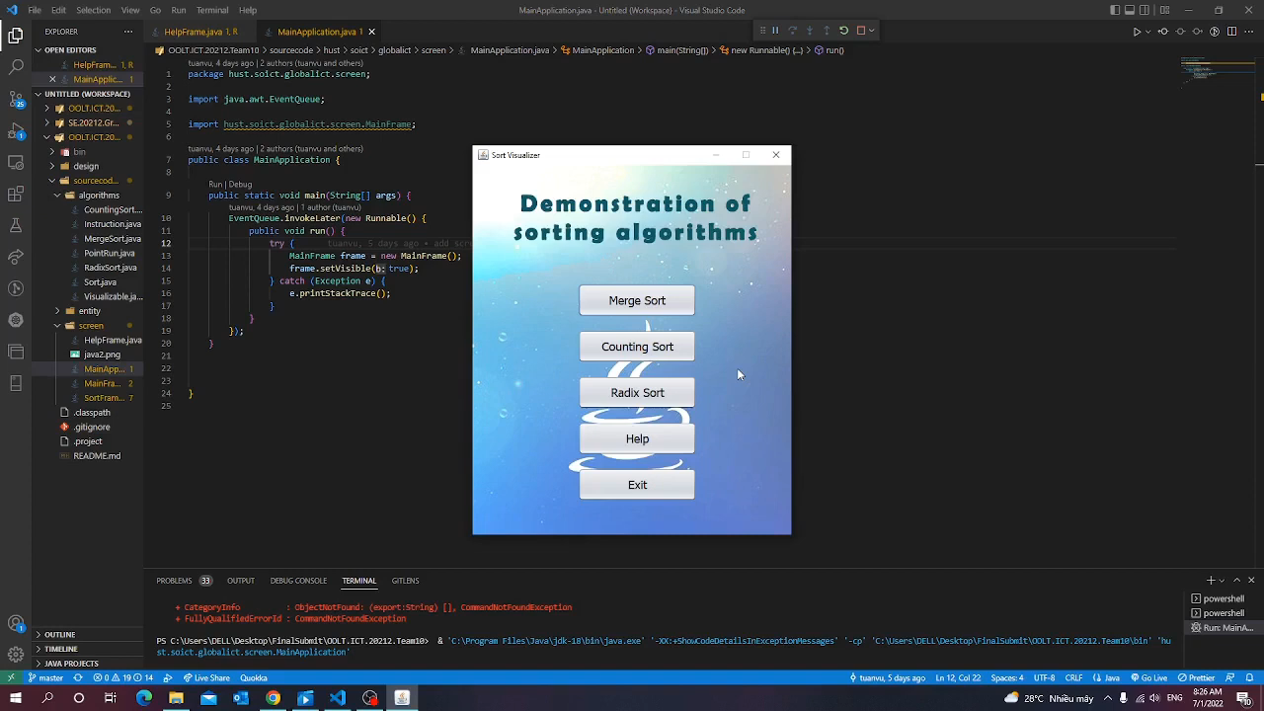
Demo video
Video link: https://youtu.be/QLIufBLqgVY

Slide 10




THANK YOU FOR LISTENING

